Slide 1
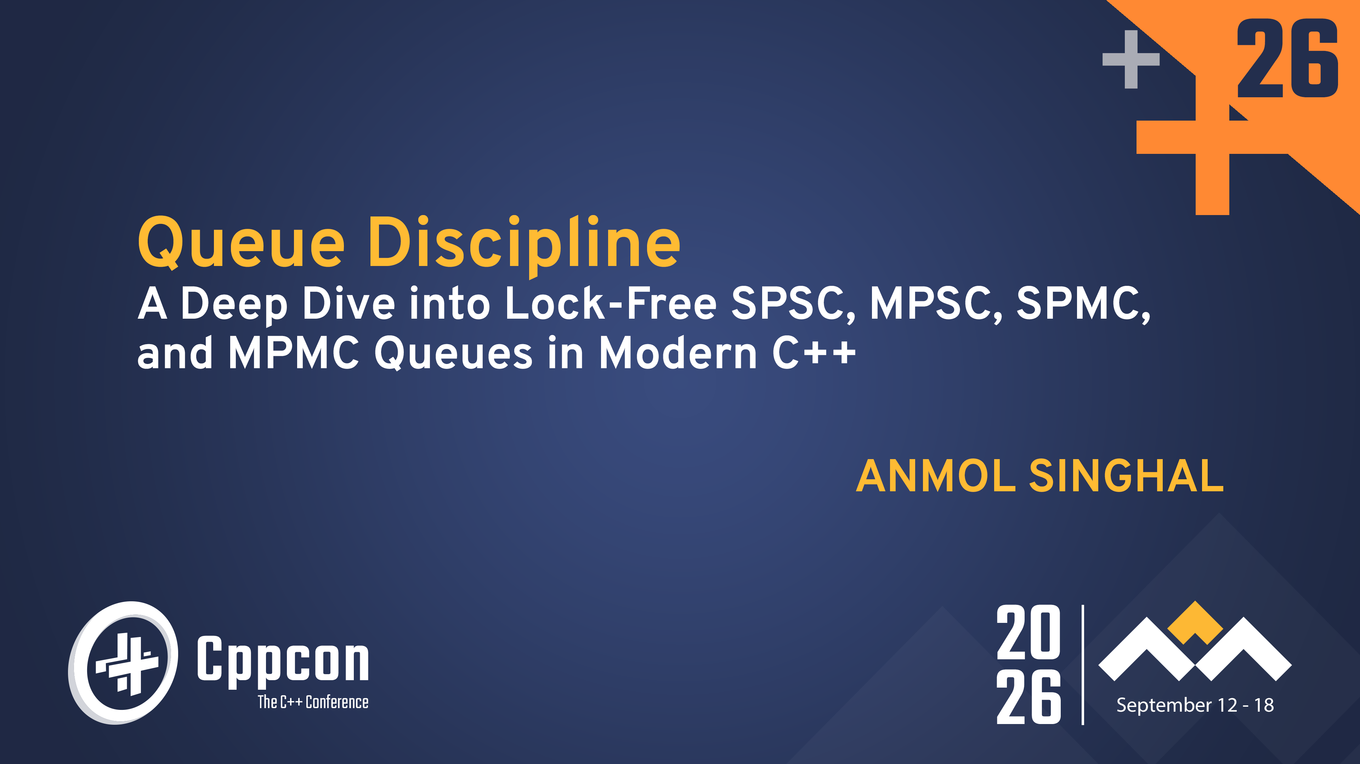

Slide 2

Queues connect execution contexts
Queues are everywhere
If work crosses an execution-context boundary, there is probably a queue involved
Processors: instruction and load/store queues
Operating systems: per-core runnable-thread queues
Networks: NIC RX/TX descriptor rings
Trading systems: market-data and order queues

Slide 3
Goal
Goals
Progress guarantees
Lock free primitives
Queue architecture
Performance
Production ready library

Slide 4
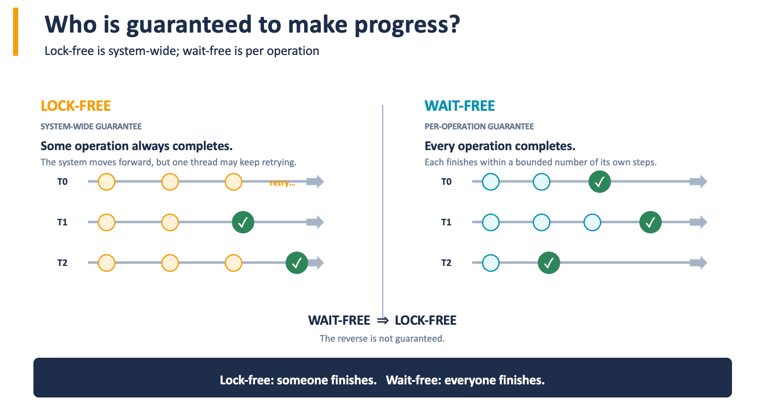
False sharing
Notes:
Define lock free better

Slide 5
Atomics make shared updates indivisible
Atomics
Operations appear as a single indivisible step
ORDINARY int
counter++ is three separate steps
std::atomic<int>
fetch_add is one indivisible RMW
T0
load 0
+ 1
store 1
0
T0 +1
1
T1 +1
T1
load 0
+ 1
store 1
final counter = 1
final counter = 2
Lock-free is implementation-dependent; query is_lock_free().
ATOMIC TOOLBOX
load · store · exchange · fetch_add · compare_exchange

Slide 6
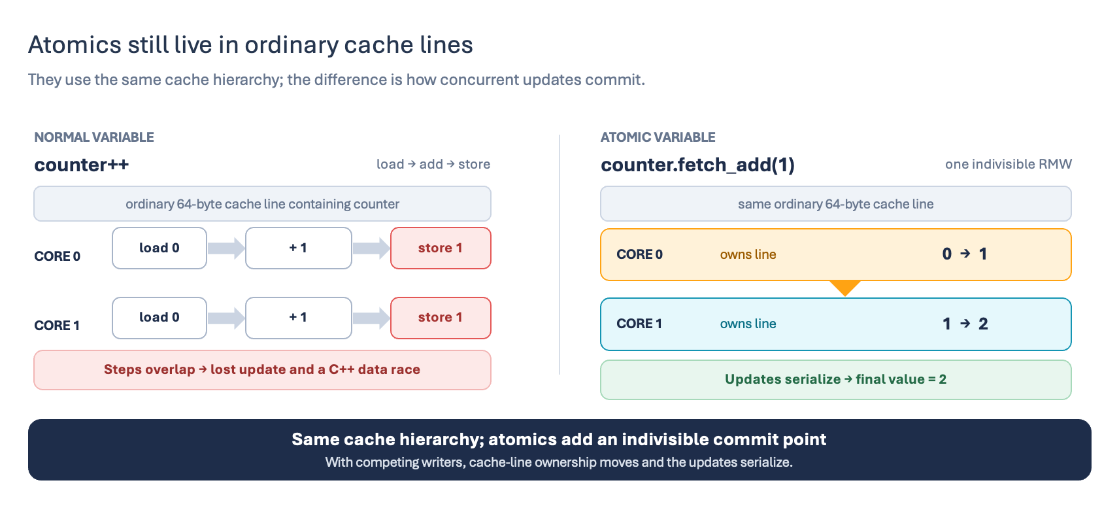
Atomics
Look under the hood
Notes:
Define cache line here
What does owning a cache line actually mean?

Slide 7
False sharing
False sharing
Independent variables contend if they share a cache line
CORE 0
CORE 1
L1 / L2
L1 / L2
atomic A++
SAME CACHE LINE
atomic B++
ATOMIC A
ATOMIC B
Different atomics, same cache line → ownership still bounces (false sharing)

Slide 8
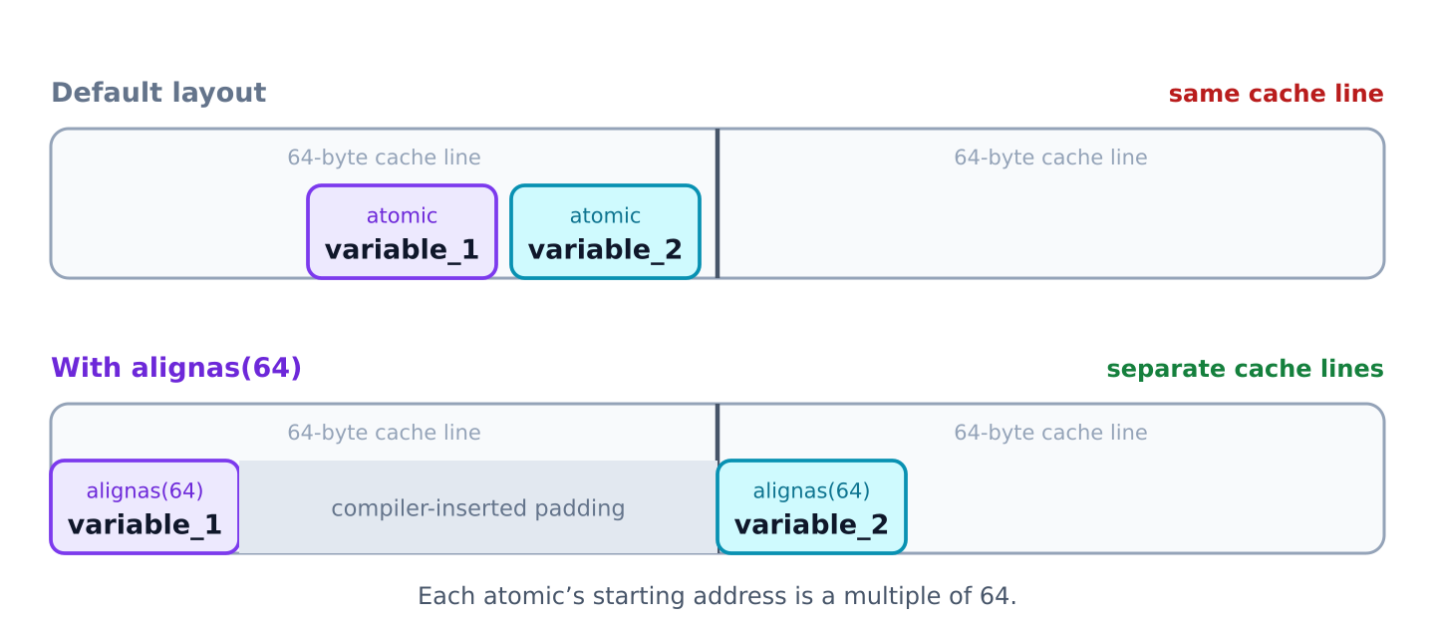
alignas controls placement—not object size
alignas
Places data on specific byte boundaries like 16, 32, or 64 bytes

Slide 9
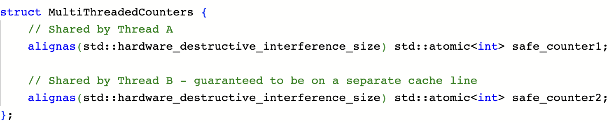
alignas controls placement—not object size
alignas
std::hardware_destructive_interference_size
Demo

Slide 10
Aligned shared state by ownership
Memory ordering
Controls when operations around an atomic become ordered and visible across threads
Notes:
Can mention release is flush cache, acquire is reloading cache
Relaxed -
mention don't worry about it in code, we can discuss why later

Slide 11
alignas controls placement—not object size
Single Producer, Single Consumer

Slide 12
alignas controls placement—not object size
Single Producer, Single Consumer
Lock free
Wait free
Global FIFO
Bounded memory
Notes:
Why lock free? Why wait free?

Slide 13
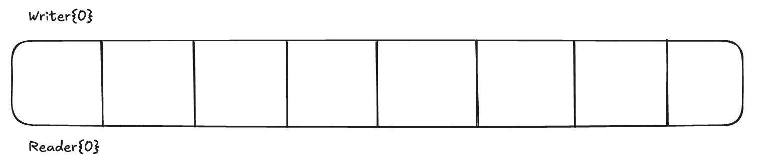
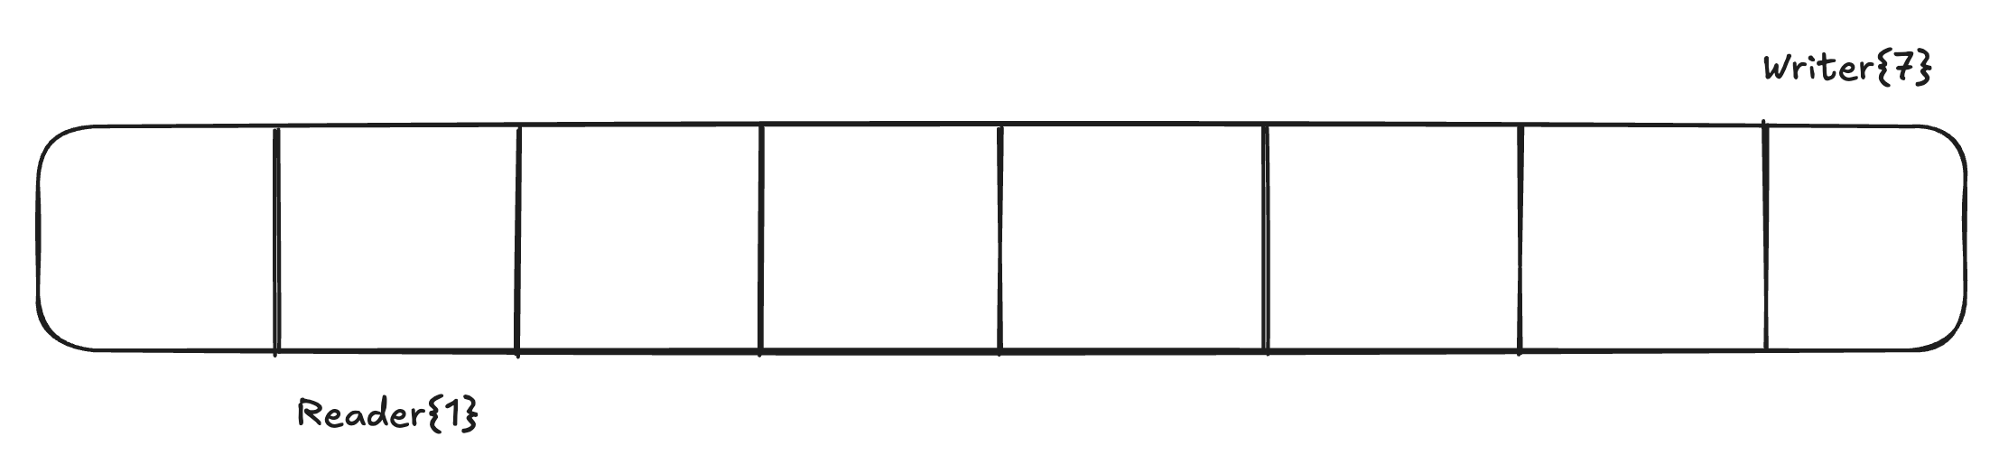
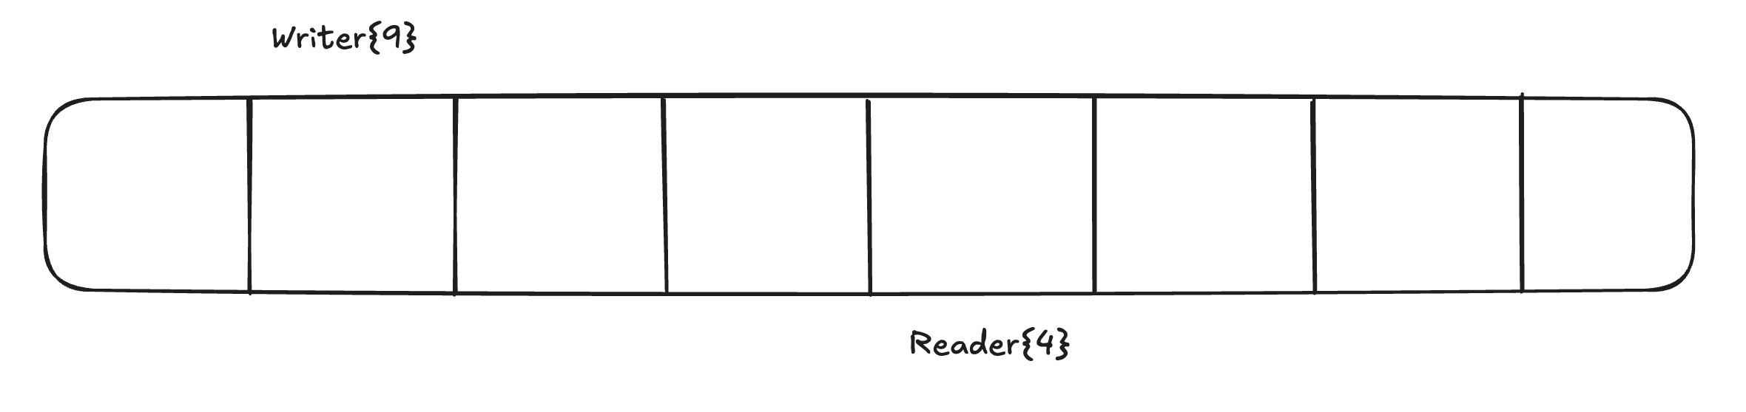
Single Producer, Single Consumer
Circular Ringbuffer
Writer and reader index are monotonically increasing, index into array using modulo

Slide 14
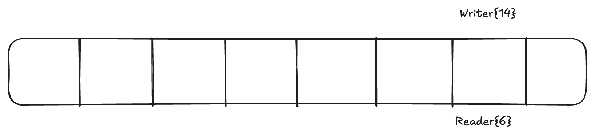
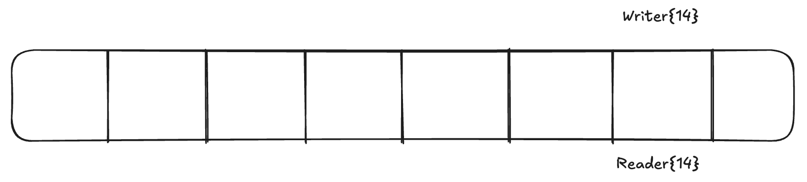
Boundary conditions
Boundary conditions
Writer checks if the queue if full:
writer == reader + size
Reader checks if queue is empty:
reader == writer

Slide 15
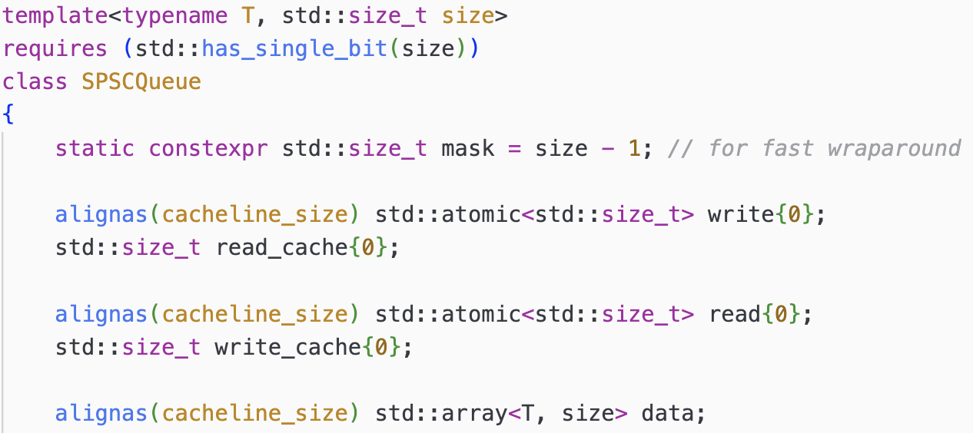
SPSC Queue
SPSC Queue
Constrain size to be power of 2 for faster indexing
Cursor for the producer
Cursor for the consumer
Cached peer cursor
Notes:
Cache is complicated to follow, code in general is complicated to follow

Slide 16
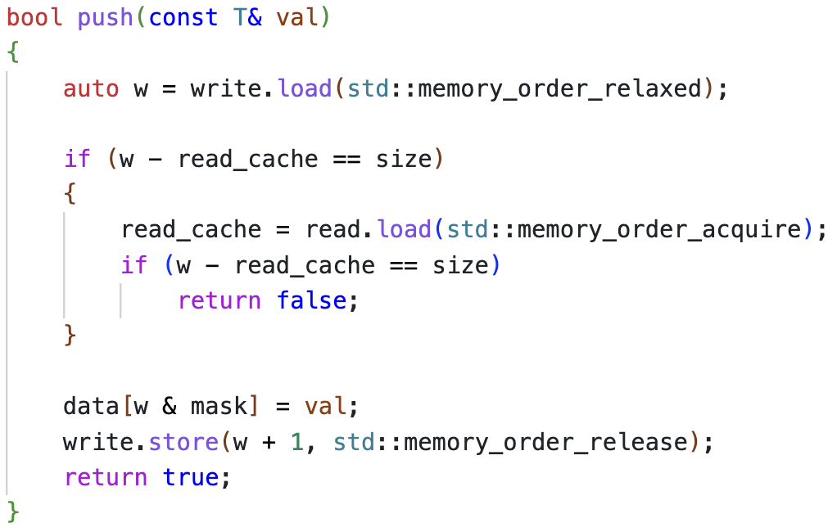
SPSC Queue
SPSC Queue Push
Load write cursor
Check if queue full with cached peer cursor
Reload read cursor
Progress cursor with release

Slide 17
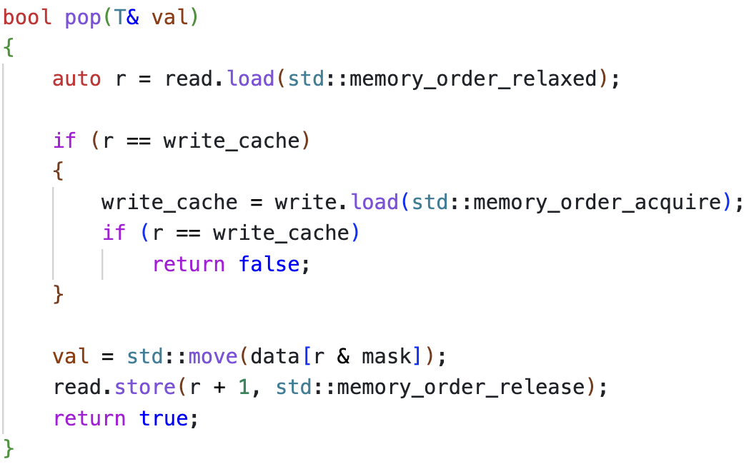
SPSC Queue
SPSC Queue Pop
Godbolt benchmark

Slide 18
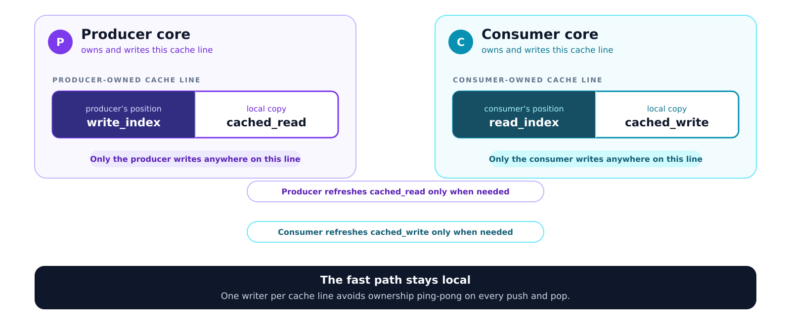
Aligned shared state by ownership
Key takeaway: Memory alignment

Slide 19
alignas controls placement—not object size
Single Producer, Multiple Consumer
Market data gateways, Video encoders, Web servers
Single producer
Multiple consumer
Circular FIFO
Work sharing queue

Slide 20
SPSC Queue
What do we need?
Performance
  Fast producer path
  Low per-item overhead
Scaling
  Minimal coordination among threads
  Single-consumer ownership per item
  Even distribution of work among consumers

Slide 21
SPSC Queue
How should our queue work?

Slide 22
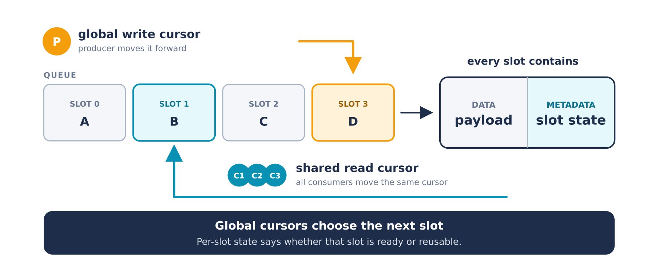
SPSC Queue
How to check for boundary conditions?
SPMC must separate slot reservation from slot reuse
Cursor maintains FIFO ordering and indicates ownership
Per slot sequence indicates slot state; Similar to Seqlock

Slide 23
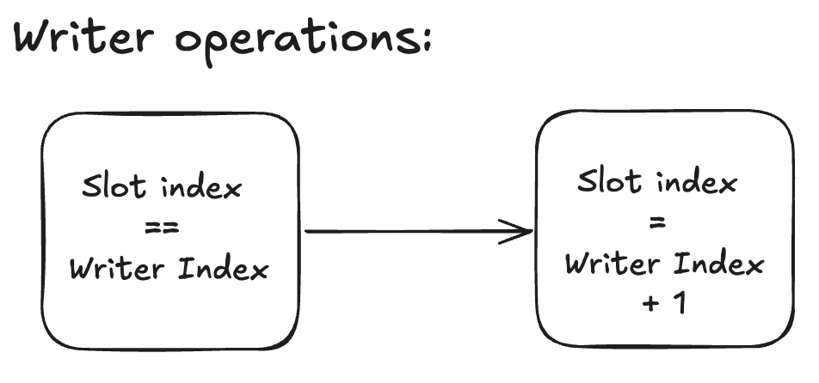
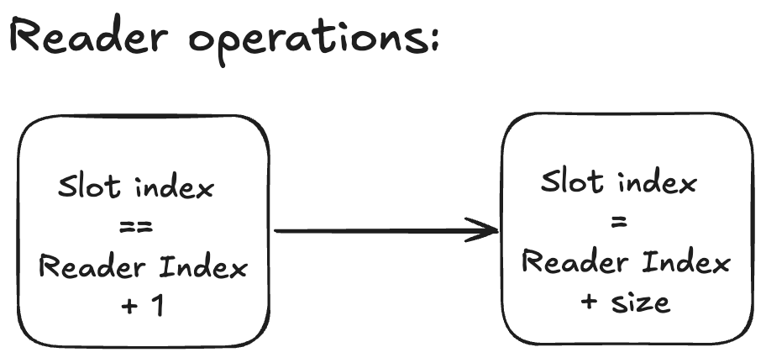
SPSC Queue
Per slot state operations

Slide 24
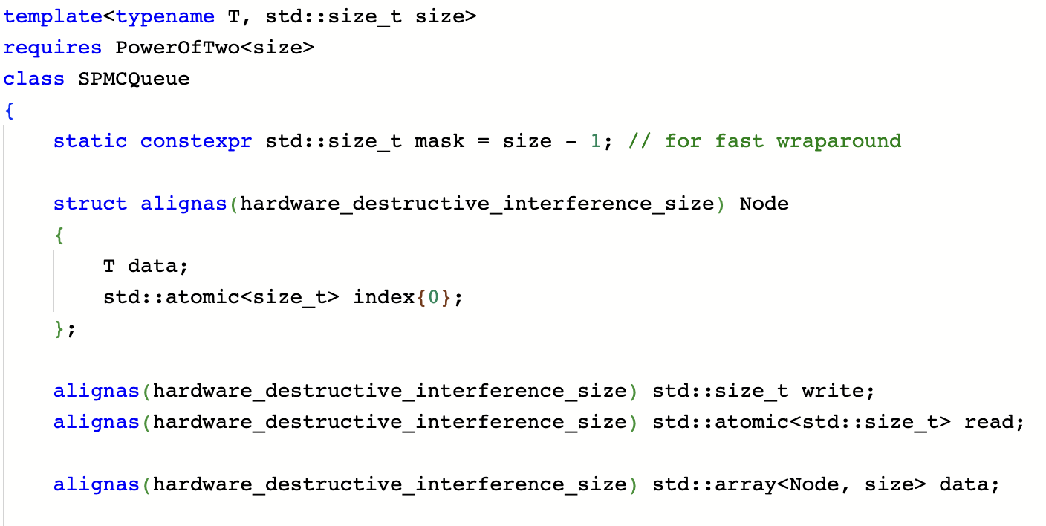
SPSC Queue
SPMC Queue
Puts every node on a separate cache line
concurrent access by reader and writer
Write cursor not accessed by readers
Read cursor supports
concurrent access

Slide 25
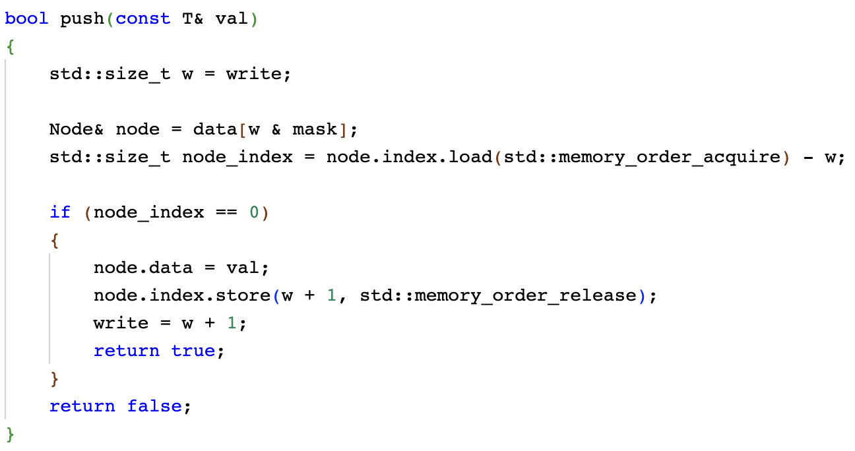
SPSC Queue
SPMC Queue Producer
Read slot
Read slot sequence
Check if slot is empty
Publish data ready
Progress cursor

Slide 26
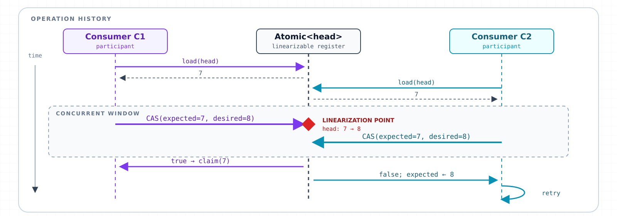
SPSC Queue
Compare and Swap
Allows concurrent state change without locks
Notes:
Do basics of CAS before discussing queue

Slide 27
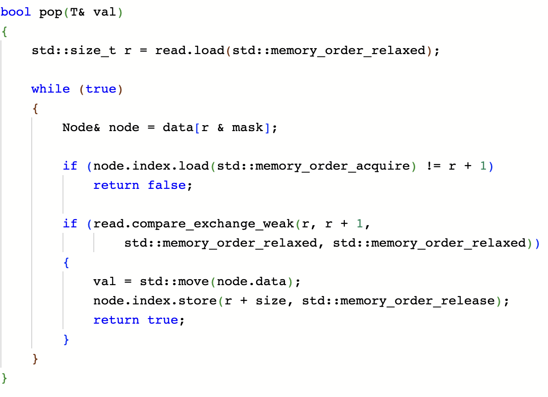
SPSC Queue
SPMC Queue Consumer
Read cursor for FIFO
Check slot seq for data state
Progress cursor using CAS and claim ownership
Publish empty slot state
Retry if CAS fails

Slide 28
SPSC Queue
Key takeaway: Compare and Swap
Conditional atomic state transition
CAS lets threads compete for a state transition without acquiring a lock
Used as a linearization point in lock free algos
C++ provides two versions:
compare_exchange_weak
compare_exchange_strong

Slide 29
alignas controls placement—not object size
Multiple Producer, Single Consumer
Funnels concurrent events into one stream
Enables efficient asynchronous work handoff
Used in trading, logging, messaging

Slide 30
SPSC Queue
What do we need?
Extremely fast enqueue without coordination
FIFO ordering
Single-consumer dequeue and reclamation
Unbounded

Slide 31
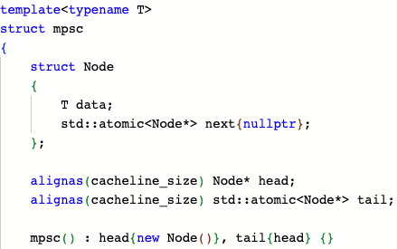
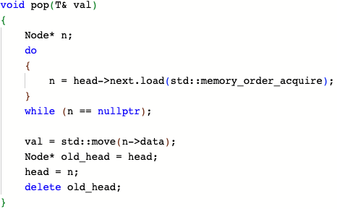
SPSC Queue
Vyukov MPSC queue
Linked List based queue
Read node having valid next
Linked list node
Move the dummy head forward
Consumer consumes at head, producer produces at tail

Slide 32
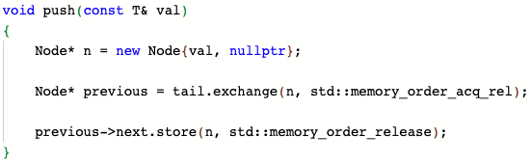
SPSC Queue
MPSC Producer
Lock free using node pool/allocators
Exchange node with tail
Connect node to the linkedlist

Slide 33
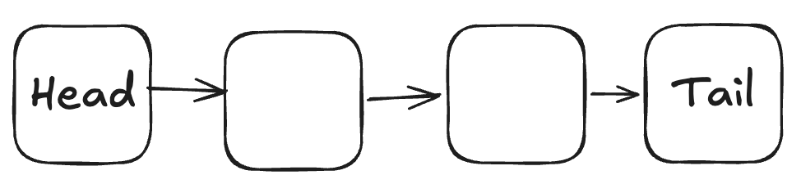

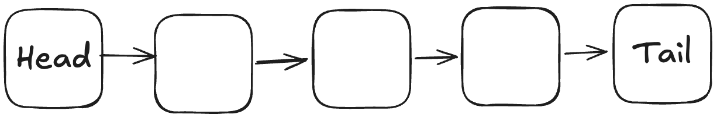
SPSC Queue
Producer operation

Slide 34
SPSC Queue
Lock free?
Preempted

Slide 35
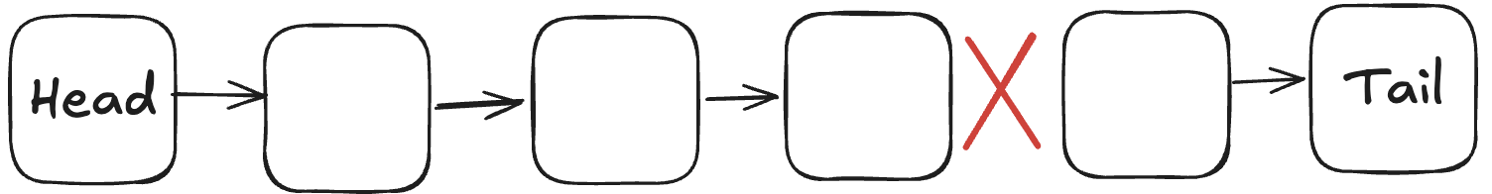
SPSC Queue
Lock free?
Consumer can be blocked from progress if producer stalls

Slide 36
SPSC Queue
SPMC/MPSC are not lock free
Slot ownership and data operations are multiple instructions
Thread stall can eventually stall the entire system
SPMC:
  Consumer first claims slot by CAS
  If thread stalls after claim, it eventually blocks producer
MPSC:
  Producer stall after exchange can block consumer

Slide 37
SPSC Queue
Key takeaway: Lock less ≠ Lock Free
Using atomics instead of mutex doesn't guarantee progress
Where can a thread be suspended?
Who depends on that thread’s next step?
Can another thread complete or repair it?
Progress is a property of the whole protocol, not its individual primitives

Slide 38
Vyukov queue vs Michael Scott queue
Michael Scott MPSC queue is lock free
CAS operation in the producer path i.e. retry loops
Vyukov queue producers have predictable performance
Consumer inherits producer scheduling delay
MPSC vs multiple SPSC?

Slide 39
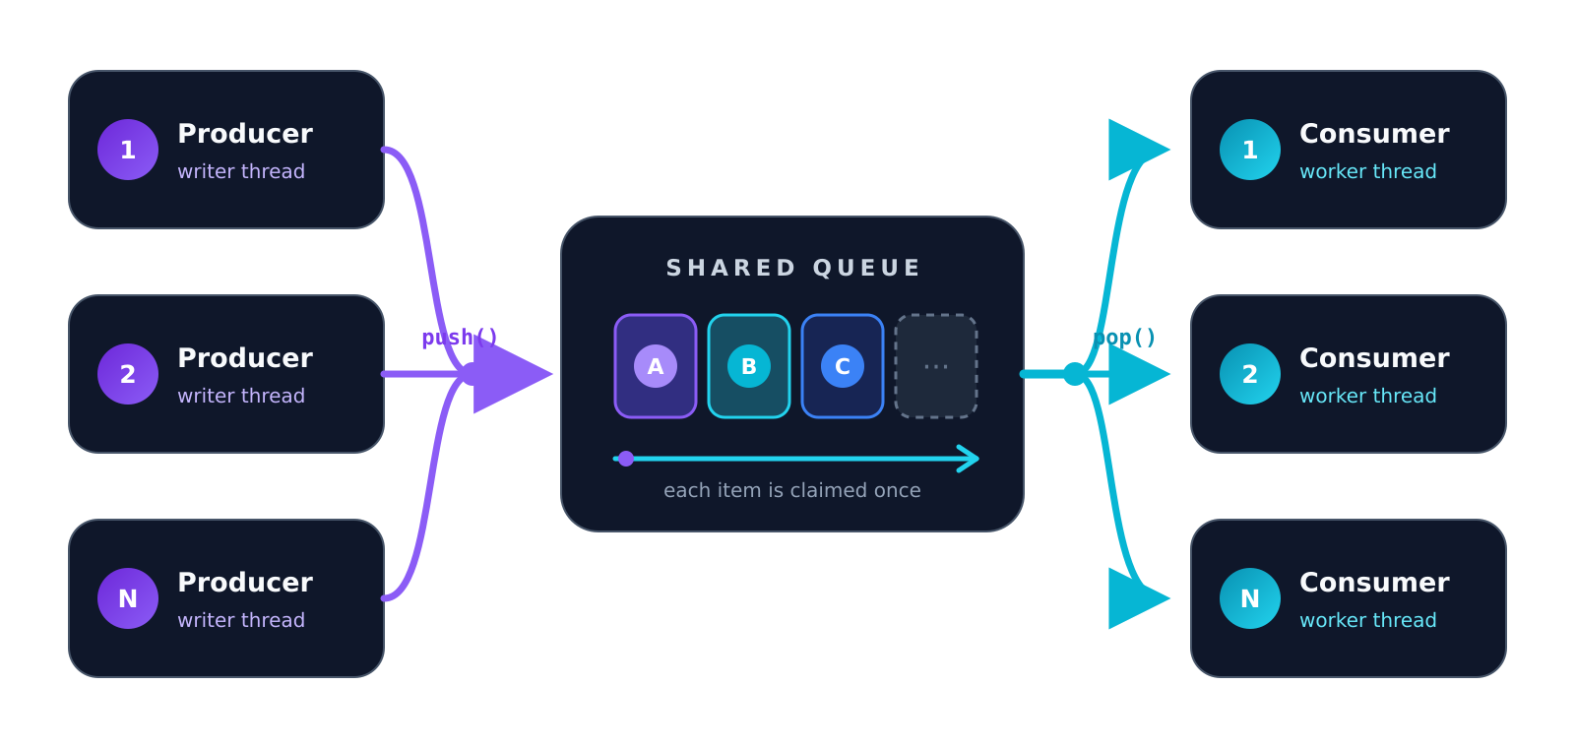
alignas controls placement—not object size
Multi Producer, Multi Consumer
Bounded circular queue, FIFO, Lock free

Slide 40
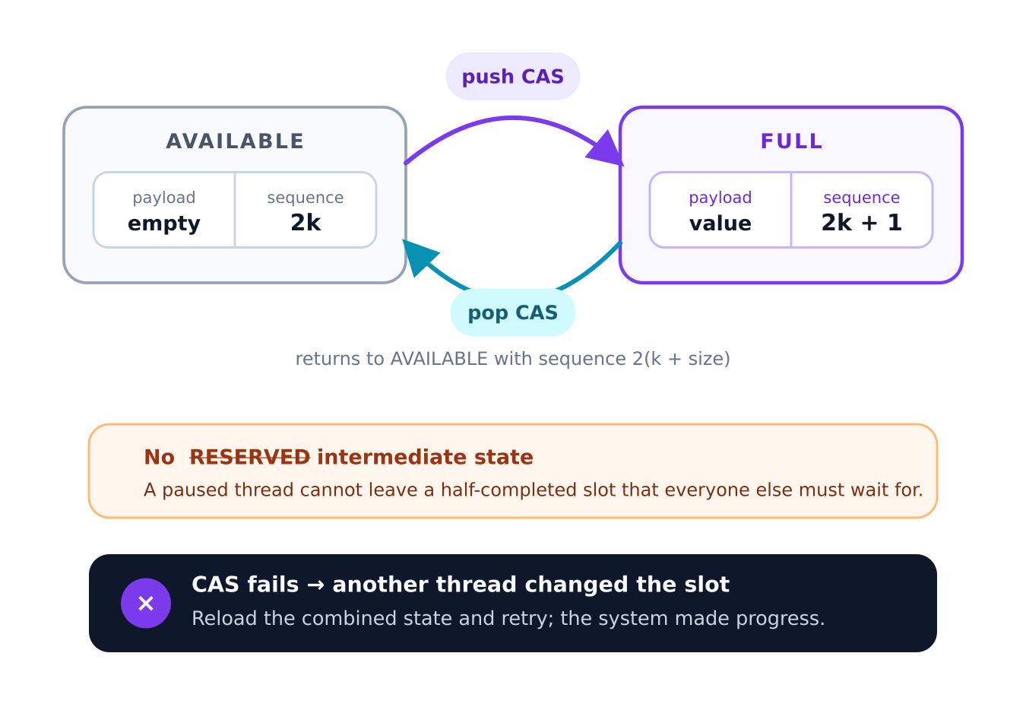
SPSC Queue
How do we make it truly lock free?
Can we publish slot in one atomic instructions?
Can we repair queue state if thread stalls?

Slide 41
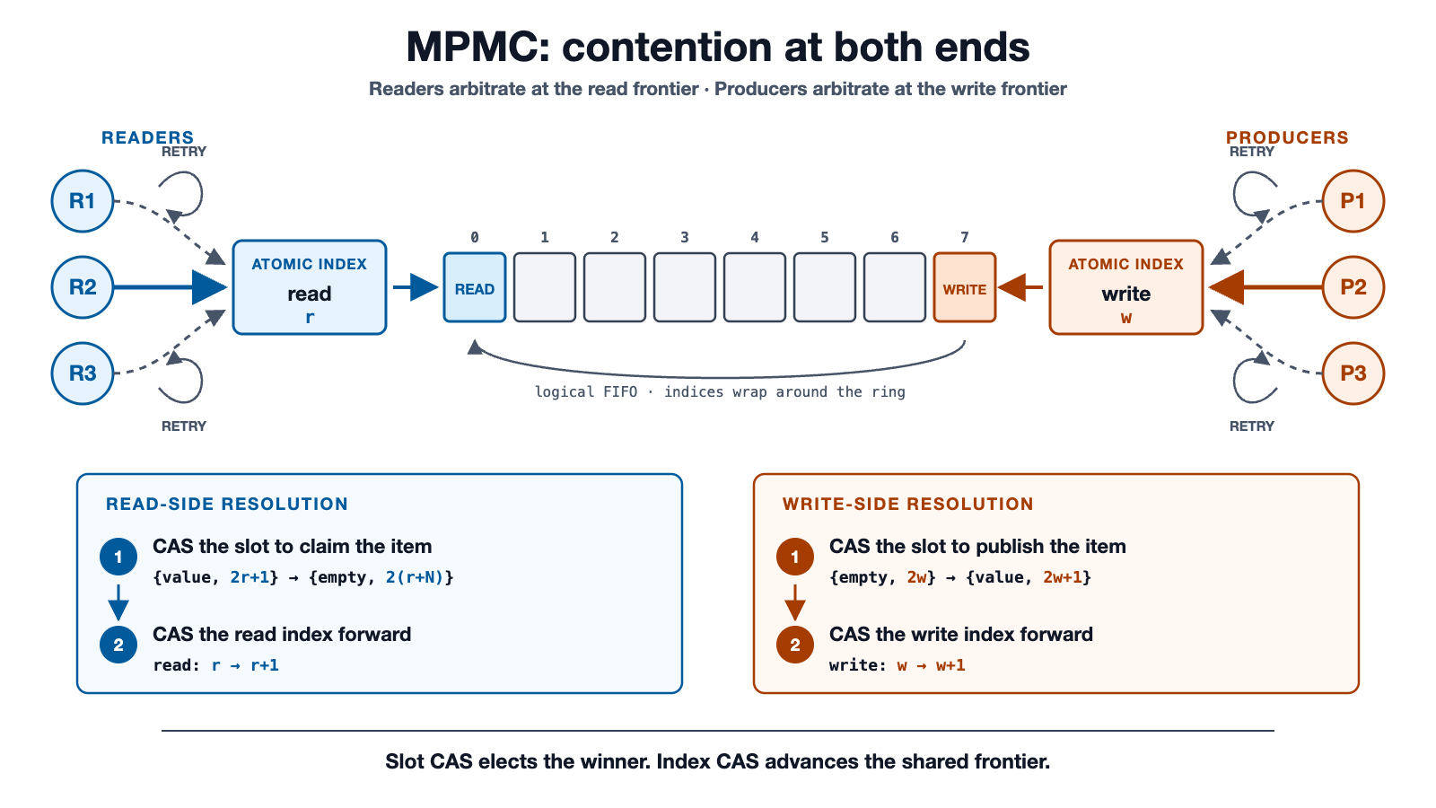
SPSC Queue

Slide 42
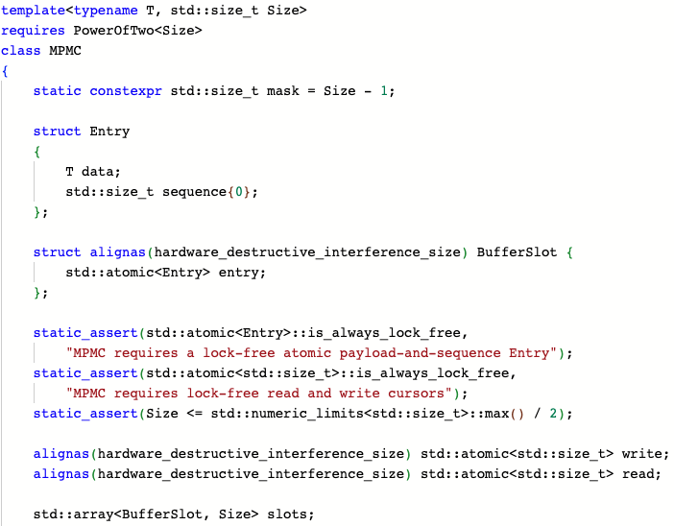
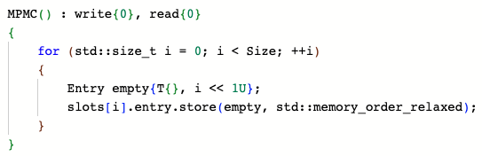
SPSC Queue
Code walkthrough
Entry contains data and sequence number
Init slots with {empty, 2*index}
Wrap entry and place on individual cache line
Assert lock free double width CAS
Define read/write cursors

Slide 43
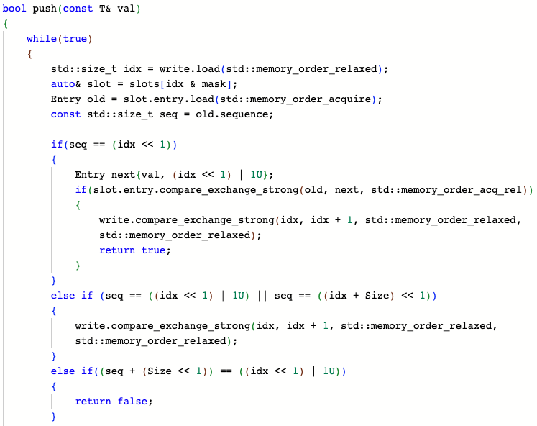
Load the next slot and read sequence
Check if empty
Write state and data into slot using one operation
CAS needed on write index
Check if queue is in broken state
Complete pending operations left by other threads
Thread coordination block
Return if queue is full
Notes:
See if explaining math is doable

Slide 44
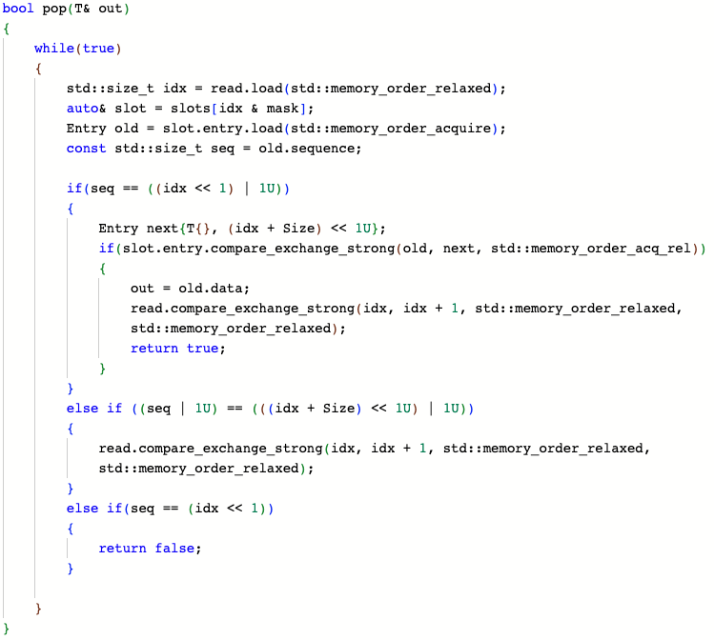

Slide 45
SPSC Queue
Key takeaway: Threads help each other
For the algorithm to remain lock-free:
Incomplete state must be detectable
Required information must be published
Another thread can complete the operation
No progress depends on the original thread

Slide 46
Queue Throughput: The Contract Is Part of the Result
SPSC
1 producer / 1 consumer
scale 0–250 M/s
SPMC
1 producer / 4 consumers
scale 0–50 M/s
Queue Discipline
229.9
Queue Discipline
46.9
Boost SPSC
199.4
Moodycamel
Boost SP ticket
19.1
148.6
MPSC
4 producers / 1 consumer
scale 0–35 M/s
MPMC
4 producers / 4 consumers
scale 0–25 M/s
non-stationary
Queue Discipline weak*
22.6
Queue Discipline CAS†
7.8
Boost SC ticket
Boost ticket‡
19.1
21.0
Rigtorp ticket‡
Boost weak / pool*
21.7
8.9
Progress trade-off
Queue Discipline
claim + publish
Ticket queues
reserve
── preemption window ──▶
publish
owner may stall here
Median throughput + p10–p90 • independent scales • million transfers / second • higher is better
* Queue Discipline MPSC is strong in ordering but weak in progress. Boost weak MPSC is weak in ordering.
† Native 128-bit CAS combines slot claim + publication and is designed to avoid the reservation gap.
‡ Boost ticket is documented linearizable. Boost and Rigtorp ticket queues reserve before completing a slot; neither provides strict lock-free progress in MPMC.
Threadripper PRO 7975WX • GCC 15.2 • C++20 • -O3 -march=native -mcx16 • 121 samples • no removals • checksum-validated
Queue-only microbenchmark; results describe this machine and workload, not universal application performance.

Slide 47
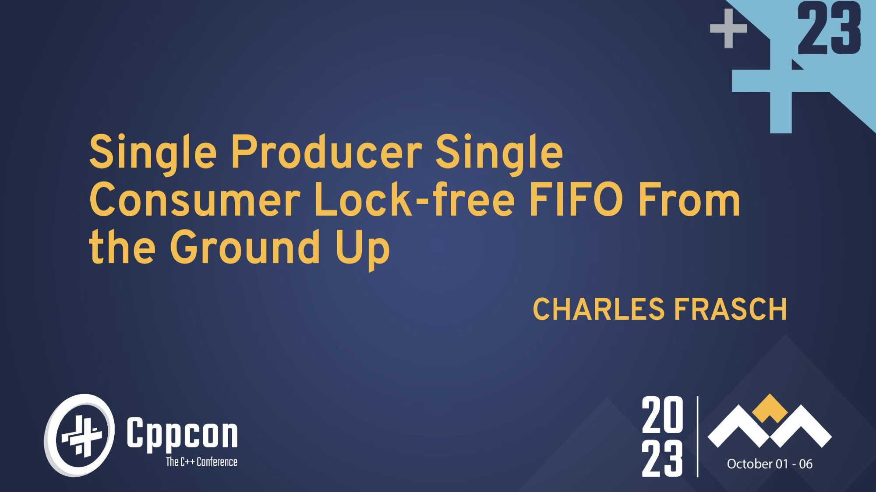
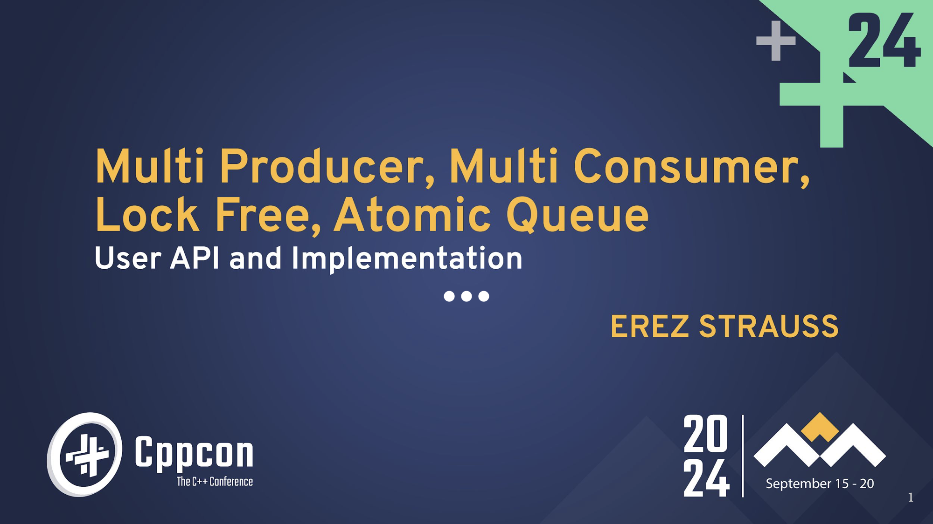
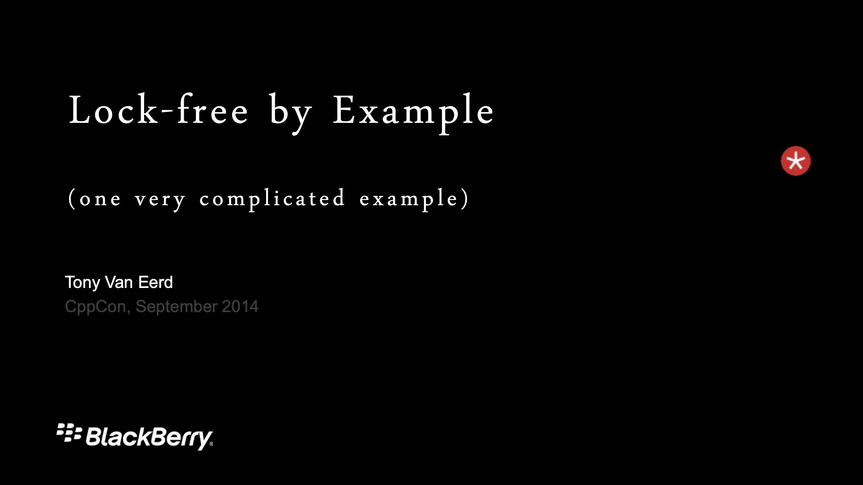

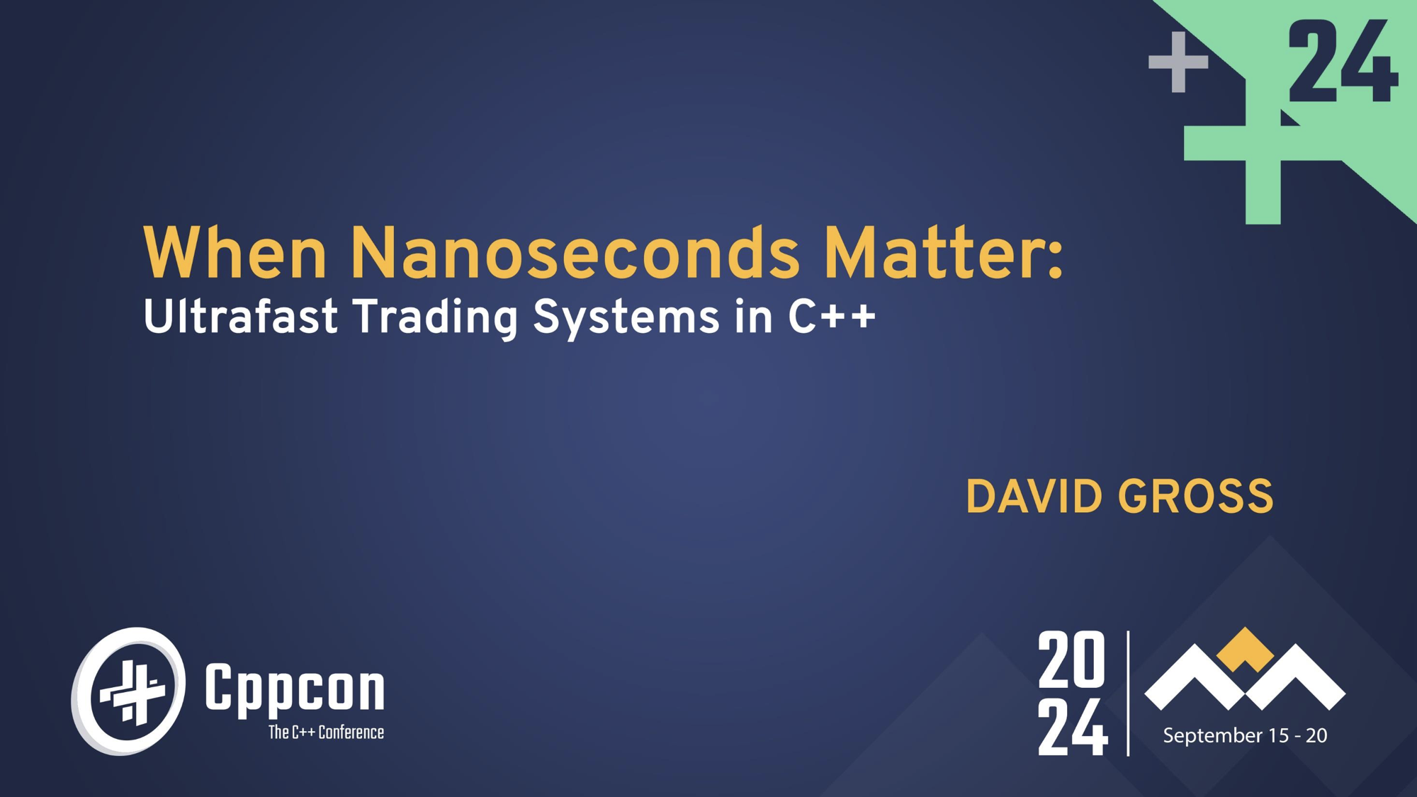
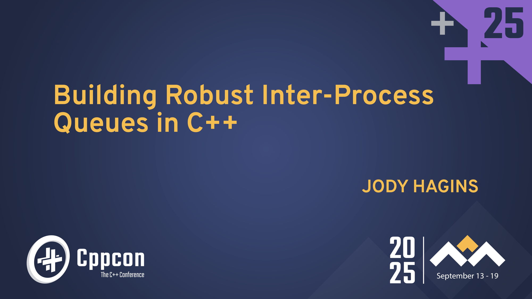
Related talks

Slide 48

Questions?
Connect with me

